Slide 1
Selenium with Ruby
Consulting - Technology

Slide 2
Agenda
Concepts of Automation
Introduction to Selenium
Introduction to Ruby
Advantages of using Ruby
Implementation areas for Ruby
Ruby Gems
External Ruby Libraries – Capybara
External Ruby Libraries – Watir
Frameworks
Types of Frameworks
Introduction to BDD
Ruby Cucumber Framework Workflow
RubyMine setup
Basic Ruby Selenium BDD Framework
Reporting
Q & A

Slide 3
What is Test Automation?
Test automation is the use of special software
To control the execution of tests and the comparison of actual outcomes with predicted outcomes
It automates some repetitive but necessary tasks in a formalized testing process already in place

Slide 4
Why to Automate?
Frequent regression testing
Repeated test case Execution is required
Faster Feedback to the developers
Reduce the Human Effort
Test same application on multiple environments
Elimination Human Error
Reusability

Slide 5

What is Selenium
Selenium is an open source automated testing suite for web applications across different browsers and platforms
It is used to automate web application testing to verify that it works as expected.
Supports multiple programming language: Java, C#, Python, Ruby, PHP and Perl.
Easy to write code .
Supports Functional, Regression, Browser Support testing, Load testing, Stress testing.

Slide 6

Introduction to Ruby
Ruby is a pure Object-Oriented language developed by Yukihiro Matsumoto
It is specifically made for developing client environments
In 2004, a framework named RoR or ‘Ruby on Rails’ was developed for this language which ignited Ruby’s success in the applications market and the lean startup methodology
Ruby is based on many other languages like Perl, Lisp, Smalltalk, Eiffel and Ada.
It is an interpreted scripting language which means most of its implementations execute instructions directly and freely, without previously compiling a program into machine-language instructions.

Slide 7
Advantages of using Ruby
The biggest advantage of Ruby over languages like Java and C/C++ is that you can accomplish task by writing fewer lines of coding. This helps in bug fixing and increases speed of development.
Ruby code can be interpreted and does not need compilation.
Ruby offers flexibility and readability
Ruby does not have type declarations, and you can assign a name to variable as needed which makes it more user friendly and simple to use.

Slide 8
Implementation areas for Ruby
Insurance applications -As there is huge test data and complex flows in an insurance domain, Ruby with its user-friendly syntax and flexibility will be a better choice for the testers
Banking and Finance applications -Because of the complexity of flows in Banking and Finance domain, some additional support apart from base selenium framework will make the automation easier and manageable. Ruby provides additional libraries like Watir and Capybara which can be used with Selenium to automate complex flows with their in-built methods.
E-Commerce
Content Management.

Slide 9
Ruby Gems
A gem is a module/Library that you can install and use in every project on your server
RubyGems is a package manager for the Ruby programming language that provides a standard format for distributing Ruby programs and libraries
The gem command is used to build, upload, download, and install Gem packages
gem install selenium-webdriver

Slide 10
External Ruby Libraries- Capybara
Capybara is a DSL for testing web applications
RubyGems is a package manager for the Ruby programming language that provides a standard format for distributing Ruby programs and libraries
Most widely used Ruby Library with combination of Cucumber and Selenium for interaction with web elements on web page.

Slide 11
External Ruby Libraries- Capybara
gem install capybara
User friendly syntax for web interaction:
visit('page_url') # navigate to page
click_link('id_of_link') # click link by id
click_link('link_text') # click link by link text
click_button('button_name') # fill text field
fill_in('First Name', :with => 'John') # choose radio button
choose('radio_button') # choose radio button
check('checkbox') # check in checkbox
Starting a browser:
driver = Capybara::Selenium::Driver.new

Slide 12
External Ruby Libraries- Watir
Watir stands for Web Application Testing In Ruby
Watir is an open-source family of Ruby libraries for automating web browsers
When working with Ruby, watir is recommended to use as it exploites the benefits of Ruby which makes the code easier, simpler and less lines.
gem install watir

Slide 13
External Ruby Libraries- Watir
Code to open a browser:
require 'watir’
Watir::Browser.new :chrome
Locating elements with watir:
t = browser.text_field id: 'firstname’
t = browser.radio value: 'female'

Slide 14
Framework
An Automation Framework may be defined as a standard set of design principles, which maximizes the efficiency of test automation.
Maximum code reusability
Minimal maintenance effort for the scripts
Test data externalization
Robust error handling mechanism
Ease of script development
Detailed reporting mechanism
Involvement of non technical user

Slide 15
Types Of framework
Data Driven Framework
Keyword Framework
Hybrid Framework
BDD Framework

Slide 16
Behavior Driven Development Framework
Behavioral Driven Development (BDD) testing uses natural language to describe the “desired behavior” of the system that can be understood by the developer, tester and the customer.
Tests are written in plain text in the format of Given, When and Then statements
Given statement specifies what all the pre-conditions are
When statement specifies what all the conditions are
Then condition specifies what is the expected outcome
These steps written in plain text hide the technicalities and complexities of the automation scripts bound underneath, thereby making it simpler for a non-technical person to understand what really is supposed to happen.

Slide 17
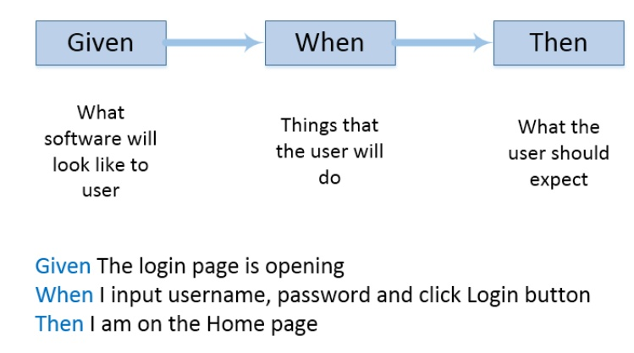
Behavior Driven Development Framework

Slide 18
Behavior Driven Development Framework
Cucumber is a software testing tool which adopts the Behavior Driven Development (BDD) approach of application testing along with Selenium Web Driver
Create Feature file where we define what our test is going to do. The steps must be in the form of Given, When and Then statements
Corresponding to our feature file, we create a separate Step Definition class to declare our functions for each of our steps specified in the feature file
We will now need to create a Java class which hosts the definitions of all the functions that we have declared for each of the feature file steps
Now that we have written our Selenium automation code, we will go back to our Step Definition file and call these functions in those declarations as shown below
Feature File
Automation Library
Business Facing
Technology Facing
Scenarios + Test Data
Step Scripts
Steps
Step Definition

Slide 19
Behavior Driven Development Framework
Advantages:
The steps of the feature file hide the actual implementation of the Selenium code, thereby making it easier for anyone from a non-technical background to understand what really is happening. It bridges the gap between the technology and the business teams working on a testing project.
Reusability of code is another plus point of this type of framework. Since Cucumber maps each and every step with a function or a method, we may come across another test case wherein we require a similar step to be performed. In such a situation, we can just reuse the step from the feature file.
When the test data changes, we need not rework on the Selenium scripts that we have already written. Cucumber allows to change the values in the feature file itself.

Slide 20
Ruby Cucumber Framework Workflow
Feature File
Step Definition
Utilities
env.rb
Page Objects
Test Results
Config

Slide 21
Setting Up Ruby Mine
RubyMine is most popular IDE used for Ruby programming. Other IDE’s like Eclipse also supports Ruby programming but RubyMine as is built specifically for Ruby, it offers in built Ruby support than other IDEs.
RubyMine is a licensed tool.
.

Slide 22
Setting Up Ruby Mine
Installations Steps:
Download RubyMine exe. Download Link - https://www.jetbrains.com/ruby/
NOTE: RubyMine is a licensed tool, for practice the trial version of 30 days can be installed.
Download the exe depending upon the OS in the host system i.e Windows/Mac/Linux
.

Slide 23
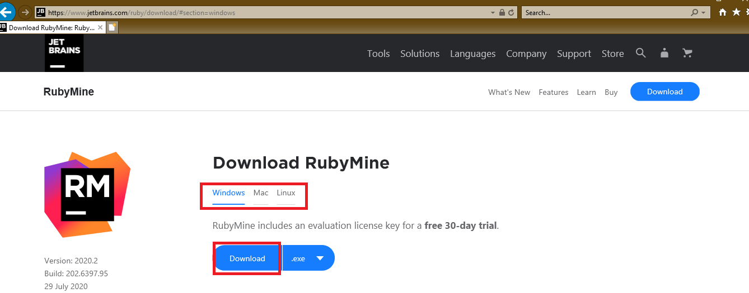
Setting Up Ruby Mine
.

Slide 24
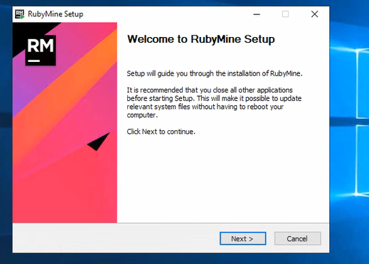
Setting Up Ruby Mine
Click next on the setup dialog
.

Slide 25
Setting Up Ruby Mine
Click next on the setup dialog
.

Slide 26
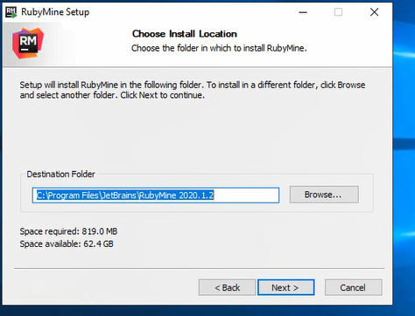
Setting Up Ruby Mine
Choose the destination location to install and press Next
.

Slide 27
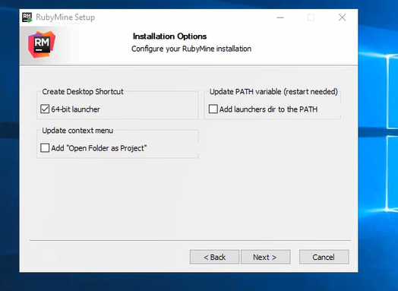
Setting Up Ruby Mine
Select 64-bit launcher at Installation Options and press Next
.

Slide 28
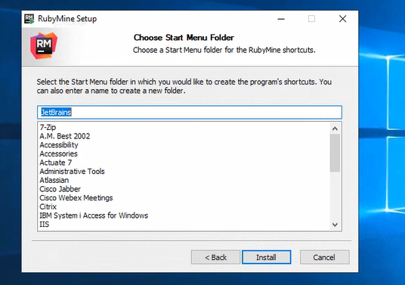
Setting Up Ruby Mine
Click Install on the next window
.

Slide 29
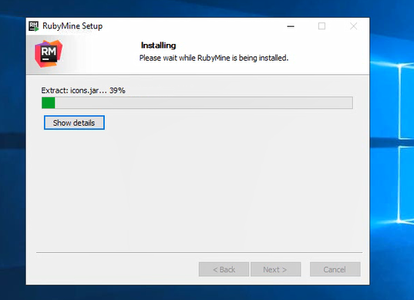
Setting Up Ruby Mine
Installation will start. After the installation is complete press Finish button to complete the setup
.

Slide 30
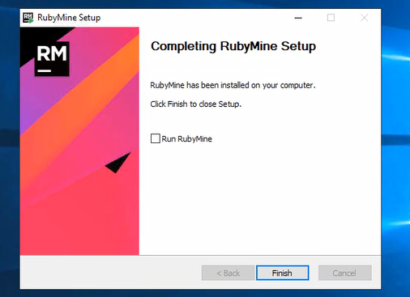
Setting Up Ruby Mine
.

Slide 31
Basic Ruby Selenium BDD Framework
To create a basic Ruby Selenium BDD Framework we require following installable:
Ruby+devkit
Selenium-webdriver gem
Cucumber gem
Chromedriver exe
.

Slide 32
Basic Ruby Selenium BDD Framework
Installation of Ruby:
Go to https://rubyinstaller.org/ and download Ruby+devkit with msys2 for any version available.
Once downloaded click on the ruby installer exe to install Ruby on windows machine.

Slide 33
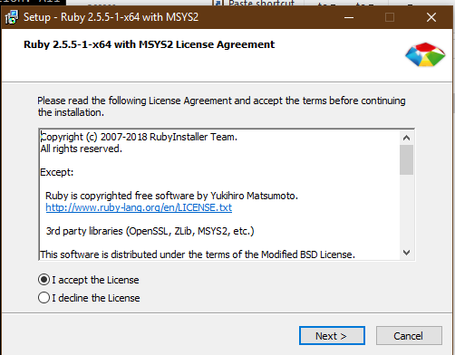
Basic Ruby Selenium BDD Framework
Click I accept on the license agreement for installation and click Next.

Slide 34
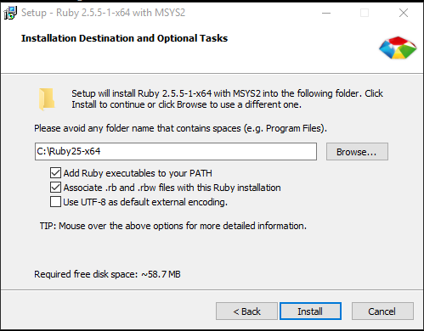
Basic Ruby Selenium BDD Framework
Click Install on the next window.

Slide 35
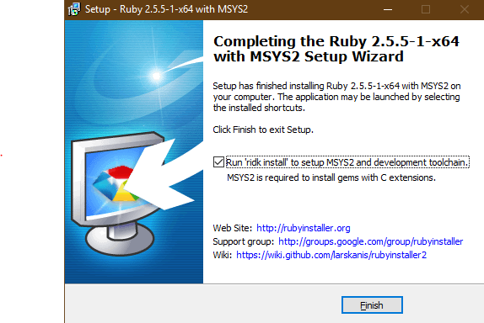
Basic Ruby Selenium BDD Framework
Select MSYS2 checkbox followed by ‘Next’ on next window to start installation and click ‘Finish’ once the installation is complete.

Slide 36
Basic Ruby Selenium BDD Framework
Command Prompt window will open post installation
Check if ruby is installed with command ‘ruby -v’
Setting up Ruby gems:
Open RubyMine IDE and select Ruby SDK in Ruby SDK dropdown while opening RubyMine
Create a new project in RubyMine at path File->New Project and give the name of your project.
Click on View->Tools Window->Terminal to open the terminal in RubyMine

Slide 37
Basic Ruby Selenium BDD Framework
Once the terminal is open, install the following Ruby gems :
gem install selenium-webdriver
gem install cucumber
cucumber –init
On refreshing the IDE, the project structure with Feature folder, step definitions folder and support folder will be created automatically for the newly created project

Slide 38
Basic Ruby Selenium BDD Framework
For Reporting we can use default Cucumber html reporter which in in built with cucumber gem
Dowload Chromedriver exe from path https://chromedriver.chromium.org/downloads as per the chrome version in your system, After downloading unzip the zip file and place the chromedriver.exe file in new folder named Driver under your project in RubyMine.
To enable reporting, Create a folder log->report under main project folder and create a Ruby file in the support folder and name it as Cucumber.yml and write the following code in Cucumber.yml file:

Slide 39
Basic Ruby Selenium BDD Framework
<%
rerun = File.file?('rerun.txt') ? IO.read('rerun.txt') : ""
rerun_opts = rerun.to_s.strip.empty? ? "--format progress features" : "--format pretty #{rerun}"
output_file = "log/report/#{Time.now.strftime("%Y%m%d%H%M%S")}"
std_opts = "-f Cucumber::Formatter::Html -o #{output_file}.html -f json_pretty -o #{output_file}.json --format progress features --strict --tags ~@wip"
%>
default: <%= std_opts %> features
wip: --tags @wip:3 --wip features
rerun: <%= rerun_opts %> --format rerun --out rerun.txt --strict --tags ~@wip

Slide 40
Basic Ruby Selenium BDD Framework
Setup the env file for setup and teardown methods which is done by Before and After hooks in Cucumber:
require 'rubygems'
require 'cucumber'
require "Selenium-webdriver“
Selenium::WebDriver::Chrome::Service.driver_path = "drivers/chromedriver.exe"
options = Selenium::WebDriver::Chrome::Options.new
options.add_argument('--ignore-certificate-errors')
options.add_argument('--disable-popup-blocking')
options.add_option('useAutomationExtension',false)
options.add_argument('--disable-infobars');
browser= Selenium::WebDriver.for :chrome, options: options
browser.manage.window.maximize

Slide 41
Basic Ruby Selenium BDD Framework
Before do |scenario|
puts "Getting driver instance"
@browser = browser
end
After do |scenario|
if scenario.failed?
puts "Test failed"
puts "Exception: #{scenario.exception.to_s}"
else
puts "Test passed"
end
puts "Quitting driver"
@browser.quit
end

Slide 42
Basic Ruby Selenium BDD Framework
Create a feature file by Right clicking on the Features Folder ->New->File and name it with ‘.feature’ extension
Write your scenario in Gherkin format as below:
Feature: Application form fillup Scenario: Filling details in the application from Given I login to application And I enter name details

Slide 43
Basic Ruby Selenium BDD Framework
In the step-definition folder create a Ruby file and implement the Gherkin steps we created in Feature file as below:
Given /I login to application/ do @browser.get "https://demoqa.com/automation-practice-form/" end And /I enter name details/ do @browser.find_element(:id, 'firstName').send_keys "Anubha" end

Slide 44
Basic Ruby Selenium BDD Framework
Now Right Click on the feature file and click on ‘Run’ option in the context menu.
The scenario will open a browser and add name details in the application form.
Apart from this, we can make our framework reusable and modular by creating the following setups in the project:
Common utility
Page Object Model
Test Data handling using yaml/json/excel/properties file
Config file for parameterizing the browser, environment etc parameters

Slide 45
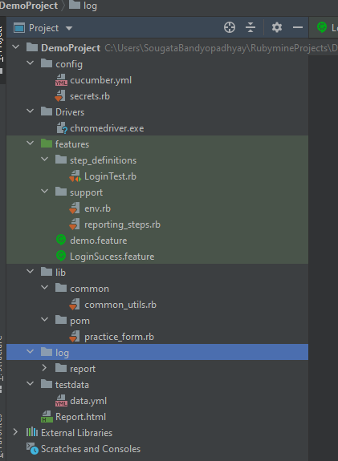
Basic Ruby Selenium BDD Framework
Our final project will look like this in Rubymine:

Slide 46
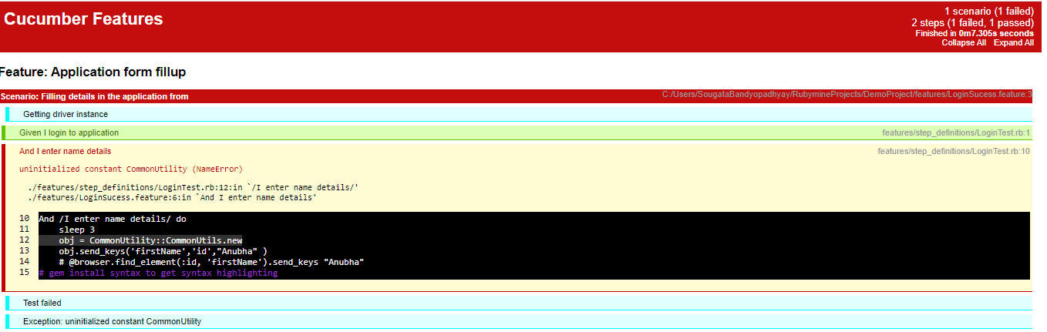
Reporting
Report generated with Cucumber will look like this:

Slide 47


Slide 48


